Slide 1




Slide 2
Autoregressive
Notes:
Hello and welcome, in this video we will start to dive into the components of the internal structure of transformers.

Slide 3
Introduction
Type of neural network models that can generate sequences of tokens, such as words or characters, one by one, based on → The previous tokens → Learned attention mechanism.
They are widely used for natural language processing tasks:
Text generation
Machine translation
Language modelling
Other modalities such as speech and images.
A
B
C
D
E
Autoregressive
Decoder
<S>
A
B
C
D

Slide 4
Autoregressive
Autoregression is a statistical process where the current value of a variable depends on its past values.
Autoregressive models learn to capture this dependency by using a recurrent or a transformer decoder that takes the previous tokens as input and outputs the next token.
https://medium.com/@YanAIx/step-by-step-into-gpt-70bc4a5d8714

Slide 5
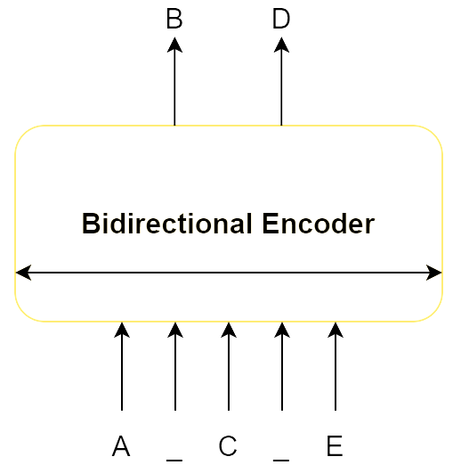
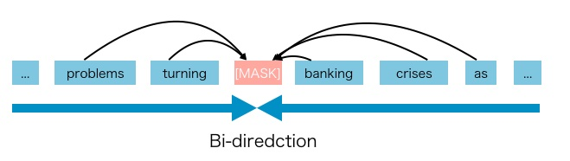
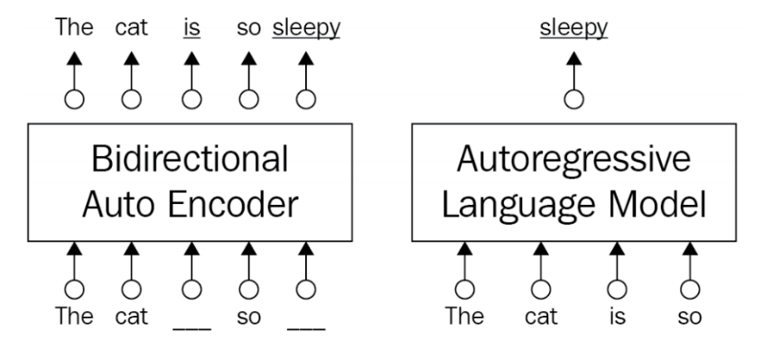
Autoencoders model drawbacks
Bidirectional → Incorporate the context of both sides of a word.
Issues With Autoencoders Model:
The corrupting [MASK] symbols that are used during the pre-training phase are absent from the data during the fine-tuning phase → leading to a pre-training-fine-tuning discrepancy.
The BERT model arguably assumes that: → The masked tokens are independent of each other.

Slide 6
Power of Autoregressive
Autoregressive models keep away from such assumptions regarding independence.
They are not affected by the pre-train-fine-tuning discrepancy.
Autoregressive models predict the next token based on previous tokens without masking them.

Slide 7
Component of autoregressive transformer models
Output Probabilities
Autoregressive transformer models make use of the decoder part of the transformer with masked self-attention.
SoftMax
V x 1
Linear
Add & Norm
Feed
Forward
Add & Norm
Masked
Multi-Head
Attention

Slide 8
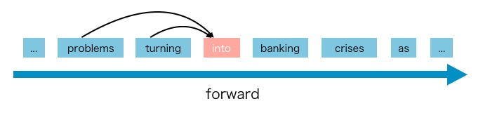
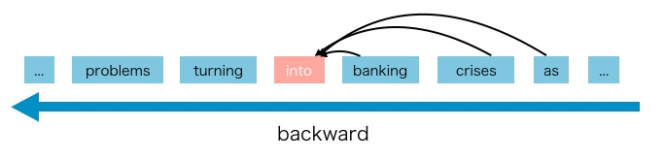
Component of autoregressive transformer models
Output Probabilities
Autoregressive transformer models make use of the decoder part of the transformer with masked self-attention.
They prevent the model from accessing words to the right of the current word in a forward direction. (or to the left of the current word in a backward direction), which is called unidirectionality
They are also called Causal Language Models (CLMs) due to their unidirectionality.
A famous example of an Autoregressive models is GPT and its successors GPT2, GPT3, and GPT4.
SoftMax
V x 1
Linear
Add & Norm
Feed
Forward
Add & Norm
Masked
Multi-Head
Attention
Inputs
https://aman.ai/primers/ai/autoregressive-vs-autoencoder-models/

Slide 9
Component of autoregressive transformer models
Output Probabilities
GPT models are made up of stack of decoder blocks excluding the encoder-decoder attention layer in the original Transformer.
SoftMax
V x 1
Linear
Add & Norm
Add & Norm
Feed
Forward
Feed
Forward
Decoder layer N
Decoder layer 1
Add & Norm
Add & Norm
Masked
Multi-Head
Attention
Masked
Multi-Head
Attention
Inputs

Slide 10
Component of autoregressive transformer models
Output Probabilities
GPT models are made up of stack of decoder blocks excluding the encoder-decoder attention layer in the original Transformer.
Each block contains a masked multi-head self-attention layer along with a pointwise feed-forward layer.
The activation in the final transformer block is fed into a SoftMax function that produces the word probability distributions over an entire vocabulary of words to predict the next word.
SoftMax
V x 1
Linear
Add & Norm
Add & Norm
Feed
Forward
Feed
Forward
Decoder layer N
Decoder layer 1
Add & Norm
Add & Norm
Masked
Multi-Head
Attention
Masked
Multi-Head
Attention
Inputs

Slide 11
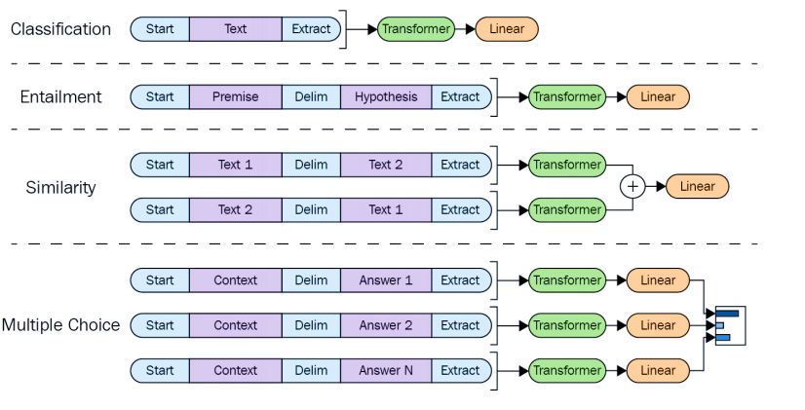
Task-Specific GPT
Only the inputs are transformed into a task specific manner, while the entire architecture is kept almost the same.
Convert the textual input into an ordered sequence according to the task so that the pre-trained model can understand the task from it.

Slide 12
Task-Specific GPT
Only the inputs are transformed into a task specific manner, while the entire architecture is kept almost the same.
Convert the textual input into an ordered sequence according to the task so that the pre-trained model can understand the task from it.

Slide 13
Task-Specific GPT
Only the inputs are transformed into a task specific manner, while the entire architecture is kept almost the same.
Convert the textual input into an ordered sequence according to the task so that the pre-trained model can understand the task from it.

Slide 14
Task-Specific GPT
Only the inputs are transformed into a task specific manner, while the entire architecture is kept almost the same.
Convert the textual input into an ordered sequence according to the task so that the pre-trained model can understand the task from it.

Slide 15
GPT Fine-Tuning
Th GPT and its successors mostly focused on seeking a particular architectural design. where the fine-tuning phase was not required.
It is based on the idea that a model can be very skilled in the sense that it can learn much of the information about a language during the pre-training phase. with little work left for the fine-tuning phase.
The fine-tuning process can be completed within three epochs and with relatively small examples for most of the tasks.
Zero-shot learning aims to disable the fine-tuning phase. The underlying idea is that the model can learn much information about the language during pre-training. This is especially true for all transformer-based models.
Pre-Training
Fine-Tuning
Inference
Smaller labelled datasets
(SQuAD,MNLI/CMNLI,
Similarity)
Fine-Tuned
Weights
Question Answering
Language generation
Name Entity Recognition
Sentiment Analysis
Summarization and more…
Large unlabeled datasets
(e.g. Wikipedia, BookCropus)
Pre-trained
Weights
Self-supervised
Training (hours to days)
Task-specific fine tuning
(minutes to hours)

Slide 16
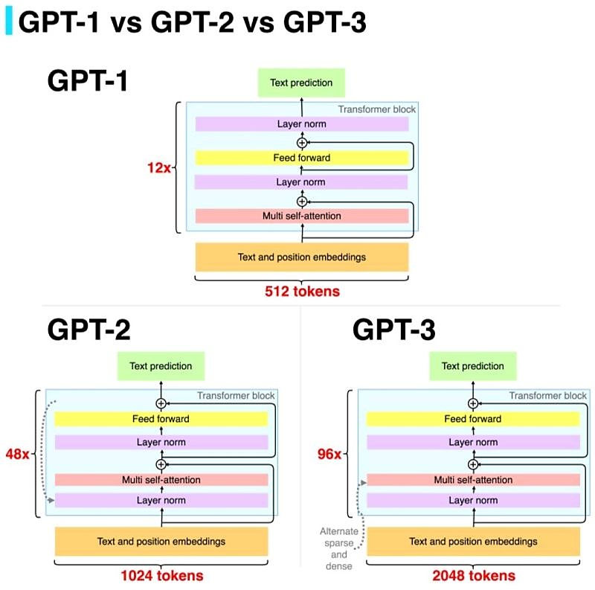
Successors of the original GPTs
The main differences between GPT model versions usually being in the model size and the dataset quantity/quality.
Due to the massive amount of data in the dataset and the large number of parameters it is trained on.
Every new model of GPT achieving better results than its previous one on many downstream tasks in zero-shot, one-shot, and few-shot learning.
GPT model’s performance increased as the parameter size and the number of examples increased.

